Slide 1


Data Science Clinic
IDI Grievances - PalmWatch
Team: Michelangelo Pagan, Vikram Ramaswamy, Andrew Kim, Tiwaa Bruks
Mentors: Launa Greer, Jingchao Fang, Ganghua Wang
TA: Harper Schwab
Notes:
Anyone
Hello everyone, today we will be presenting our progress this Spring quarter as members of the IDI Grievances Project. My name is __, and also in the group are __.
The IDI Grievances project focuses on the deleterious effects of palm oil production worldwide and hopes to create a vector by which social actors can leverage data to mitigate these effects by enacting change, whether through legislation, activism, or other means.

Slide 2
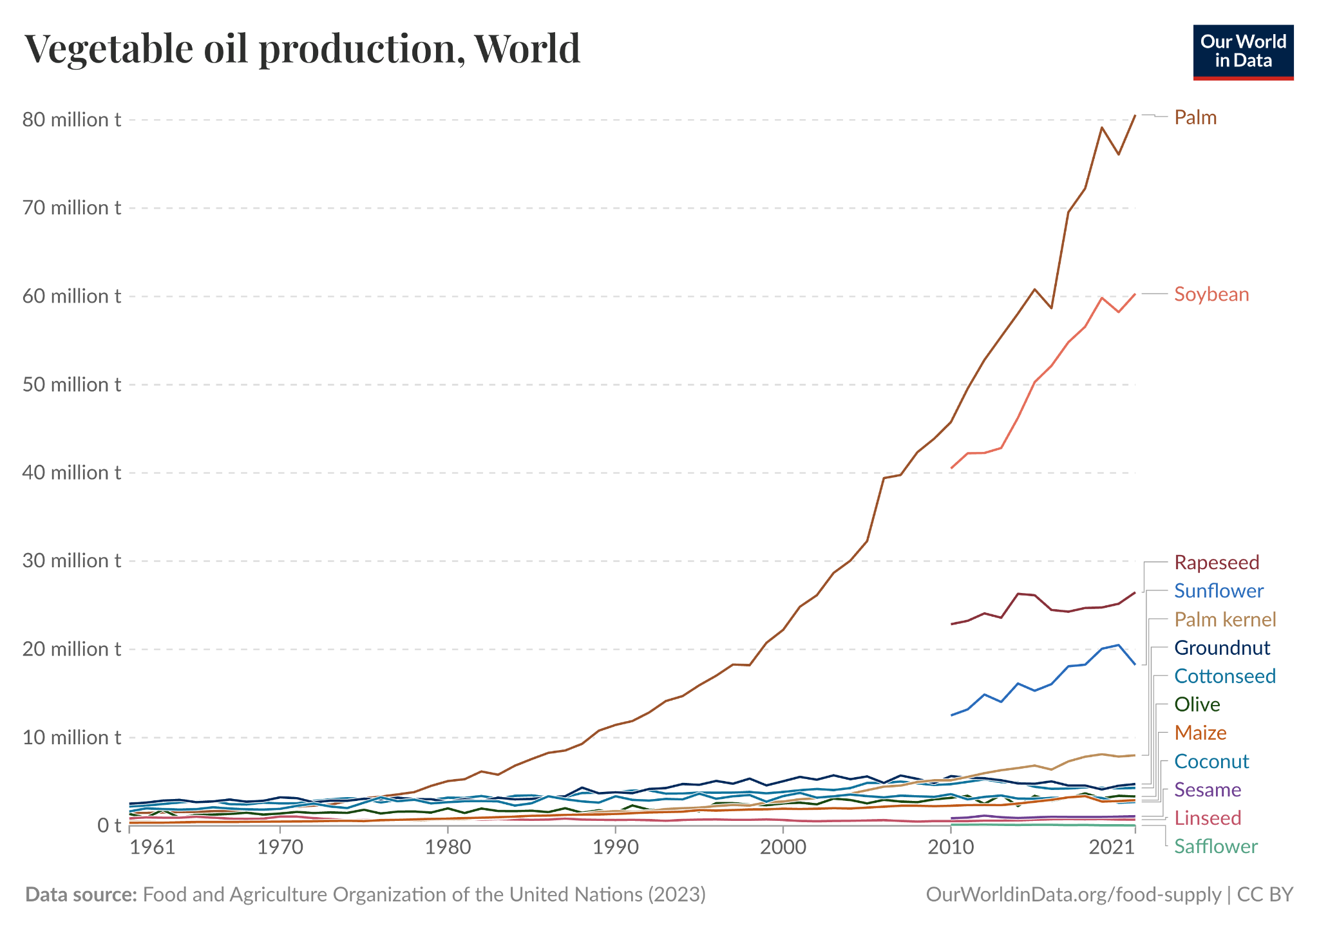
The Palm Oil Problem
Globally, Palm Oil is the most produced vegetable oil product, and it’s production continues to increase.
Why Palm Oil?
Composition
Productivity
Year-round growth
At What Cost?
Human Rights violations
Cultural loss
Environmental cost
Local economies
Hannah Ritchie (2021) - “Palm Oil” Published online at OurWorldinData.org. Retrieved from: 'https://ourworldindata.org/palm-oil' [Online Resource]
Notes:
Why Palm Oil
Composition: semi-solid at room temperatures, stable at high temperatures, and resistant to oxidation, making it easy to conserve and export
Productivity: 3.3 tons per hectare, which is by far and away the most productive crop.
Year-round growth also allows palm oil to be milled continuously
At What Cost?
Human Rights violations, often coming in the form of labor violations (as we will analyze later) put local workers at risk. Lack of proper safety measures, long hours, and inappropriate compensation are not uncommon for mills
Loss of cultural heritage sights through transformation to palm oil mills
Significant environmental losses due to deforestation that have changed the landscape of countries like Indonesia
Stripping away product from local farmers, making it difficult for them to make a living

Slide 3
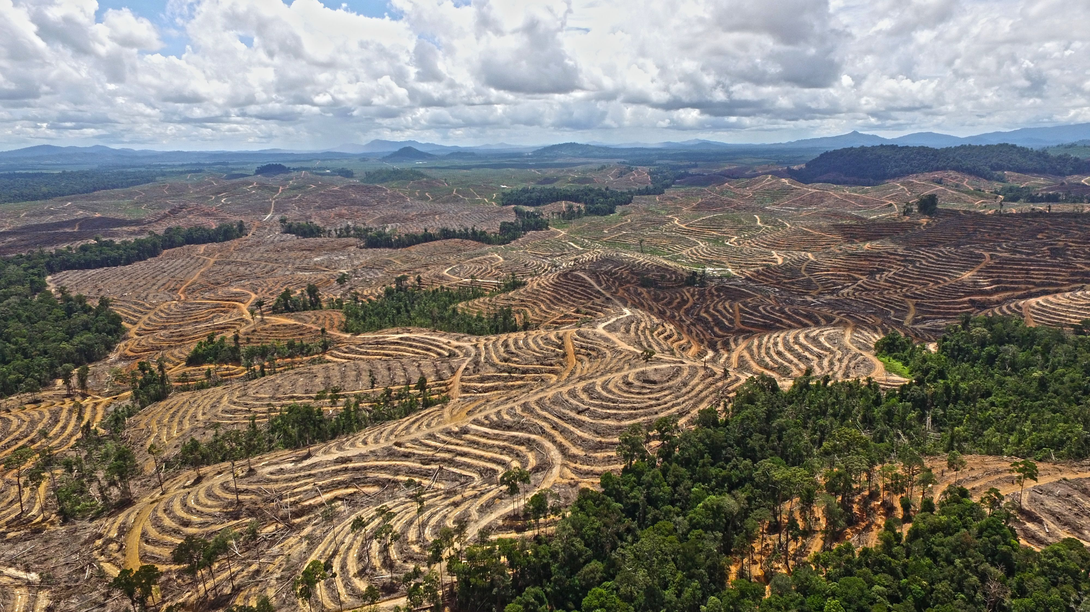
Introduction to PalmWatch
Data transparency tool created by IDI, the 11th Hour Project, and DSI, maps palm oil supply chains to connect consumer brands with their environmental and social impacts
Track submitted grievance records over time
Allow local nonprofits to identify pressure points for advocacy campaigns
Notes:
To address the issues posed by palm oil mills, Inclusive International Development, the DSI at UChicago, and th 11th Hour Project have piloted a project to map palm oil supply chain actors with their environmental and social impacts.
To accomplish this, PalmWatch needs a comprehensive dataset of grievances filed against palm oil mills globally, including the entities involved in these grievances to leverage pressure points in the palm oil supply chain
This will allow us to better understand trends in the data, including spatial trends, time trends, and common offenders
With this data, PalmWatch will allow local nonprofits and other social actors to identify pressure points for advocacy campaigns targeted at palm oil mills.

Slide 4
Data
Notes:
Now we will introduce the data sources we focused on this quarter that will help us create a comprehensive dataset of grievances and also touch on our approach for data extraction.

Slide 5





Grievance Data Sources
Structured PDF HTML Unstructured PDF
Notes:
The grievance sources we examined originate from various corporations, each with distinct structures. Most of our sources were structured as PDF reports (like Sime Darby), but we also had web pages (such as Cargill), along with Hershey’s highly unstructured PDF. When extracting this data and integrating it into our main pipeline, the biggest thing we had to account for was the individual differences in data sources and ensuring the pipeline accounted for these differences.

Slide 6
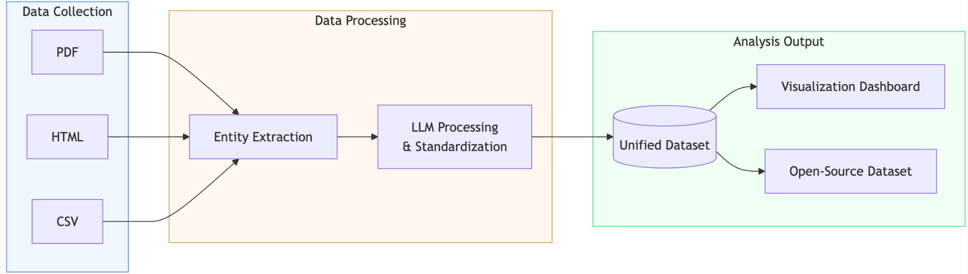
Data Extraction
Utilized web scraping tools like BeautifulSoup and Selenium to handle diverse structures
Integrated Mistral and Claude LLMs to enhance text processing, classification, and data refinement
Notes:
In terms of the extraction process, we utilized web scraping tools like BeautifulSoup and Selenium to handle diverse structures. We then performed Large Language Model Processing by using API-based models within Mistral AI and Claude to allow us to better automate summarizing our data inputs. Finally, we combined the extracted and processed information into a unified dataset that will be used to create visualizations and perform data analysis.

Slide 7
Goals and Milestones

Slide 8
Our Team’s Goals
Quarter goal: Improve build on PalmWatch dataset to include parties involved in each grievance record (mills, community groups, suppliers, etc.) and relationships between them
Objective 1: Update LLM prompting to extract entity-level data from grievance records
Objective 2: Link output dataframe to authoritative files of supply chain parties
Objective 3: Standardize output schema to ensure downstream use
Notes:
This quarter, we were tasked with expanding the existing PalmWatch dataset infrastructure to grievance parties and entities involved in the reports, as well as the relationships between them. Our overarching goals for this project were to
Update our LLM prompting in order to extract these entities from differentially recorded text data
Create output dataframes with id-linkages to authoritative mill lists (which will be expanded on in the coming slides)
Enforcing standard output schemas to ensure the downstream use of the data
More scalability and less reliance on hard-coded approaches
Preparation for a public-facing tool such as palmwatch
Old words:
This quarter, we set out to improve the build on the PalmWatch dataset to include the parties involved in each grievance record (mills, community groups, suppliers, etc.) and the relationships between them. Our goals to accomplish this were the following:
Update our LLM prompting to extract entity-level data from the grievance records.
2. Create output dataframes that link to authoritative files of supply chain parties.
3. Enforce standard output schemas to ensure downstream use of the data.

Slide 9
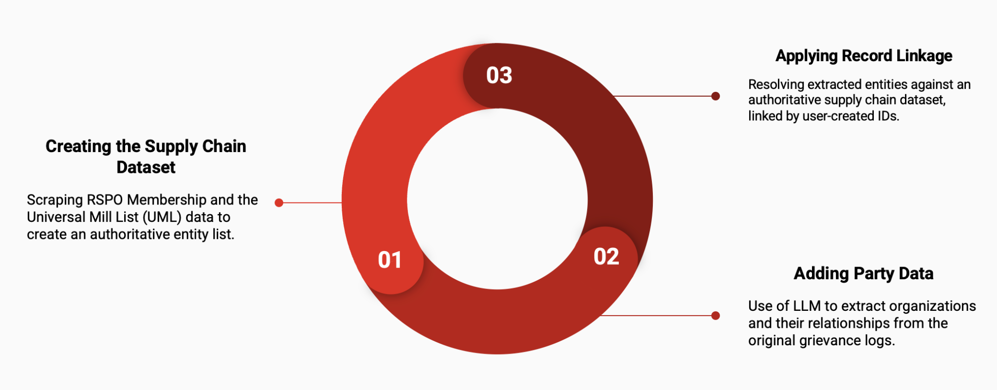
Project Milestones
After completing these primary milestones, we updated the data pipeline and visualized metrics across grievance data
Notes:
Revise Existing Pipeline
Creation of a supply chain entity dataset from authoritative sources
Addition of party/entity data (their role in the grievances and standing in the overall supply chain)
Used LLMs to enhance data processing and improve accuracy
Applying record linkage
Written to a second output csv file
Used the UML and RSPO mill lists
Synthesize Data
Update the main script
Analyze the cleaned data to produce visuals and metrics

Slide 10
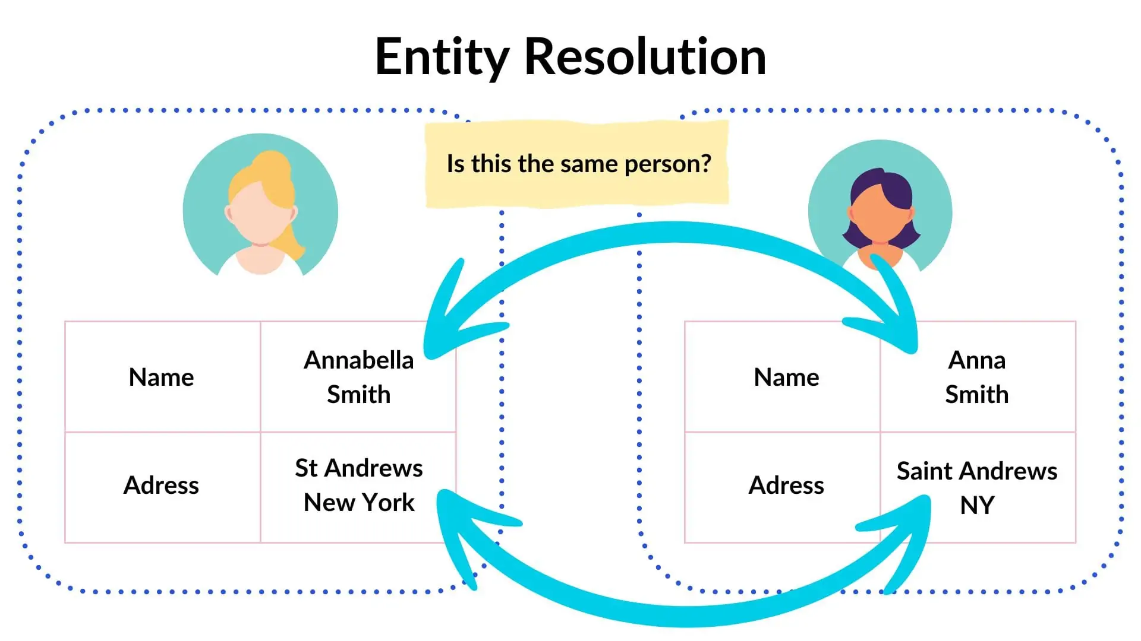
Creating the supply chain dataset
Challenge
Combining data from two inconsistent sources
Couldn’t blocking ineffective due to globally operating firms
Legal entity names vary by country
Inconsistent definitions of “parent company” across datasets
Solution
Used LinkTransformer to improve entity matching
Outperformed traditional methods (e.g., recordlinkage)
Identified and eliminated ~4,000 duplicate records
Notes:
Tiwaa
Raw notes:
Challenge:
Usual issues of entity resolution
Gather and combine data from two different sources with sometimes conflicting information and duplicates that only a human can really identify so not something that scales very easily to thousands of records
Couldn’t block by country for record linkage because large conglomerates like Nestle and Cargill own supply chain entities all over the world.
Each country has its own legal entities that confuse a lot of entity resolution packages because they think its a unique identifier for a company.
What is classified as parent company in one dataset might be called a group in another
Solution:
Deep learning model and package (linktransformer) that does a better job of reconciling duplicate records than more traditional packages like recordlinkage. Eliminated approximately 4,000 duplicate records.
Challenge
Combined data from two sources with inconsistent and duplicate records — not easily scalable due to the need for human judgment.
Couldn’t rely on country-based blocking: multinationals like Nestlé and Cargill operate globally.
Legal entity names vary by country, confusing standard entity resolution tools. Ex. LLC and Bhd
Different definitions for "parent company" across datasets (e.g., “parent” vs. “group”).
Solution
Used a deep learning-based tool (LinkTransformer) to improve entity matching.
Outperformed traditional methods like recordlinkage.
Identified and eliminated ~4,000 duplicate records

Slide 11
Findings and Visualizations
Notes:
Next, we will go over the key findings from the combined grievance dataset

Slide 12
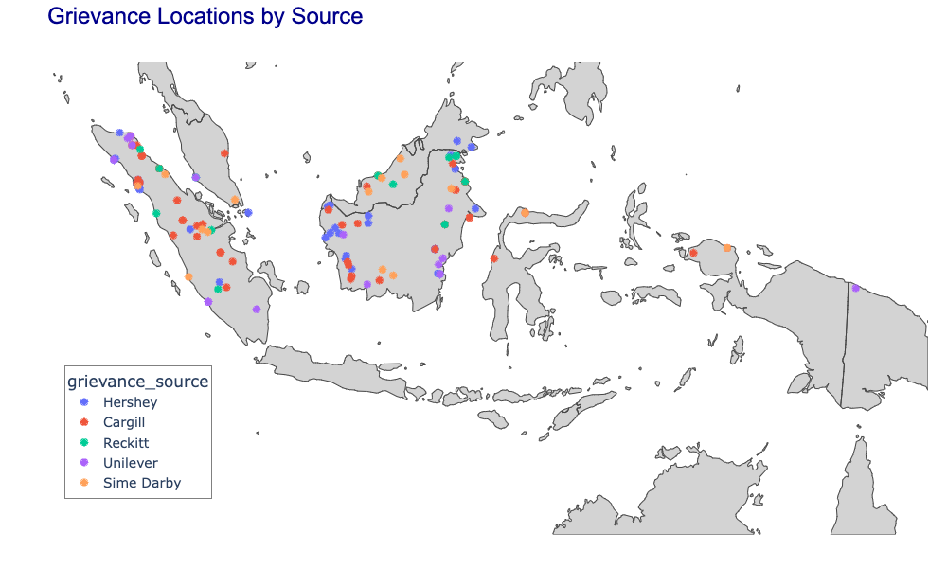
Impacted Communities
Notes:
This map visualizes the grievance reports across Southeast Asia. There were also sparse instances of grievances in South America (Guatemala) and on the Western coast of Africa.
Each dot represents either a mill or a plantation that was the subject of a grievance complaint, color-corded by the corporation that filed or acknowledged the grievance (Hershey, Cargill, Reckitt, Unilever, Sime Darby).
What becomes immediately clear is that the majority of grievances cluster in Indonesia and Malaysia, particularly around Sumatra, Borneo, and Papua. These are key palm oil-producing regions, and the concentration here highlights where communities may be disproportionately impacted by environmental or labor abuses.
This mapping allowed us to spatially identify hotspots of corporate accountability—or, in some cases, corporate negligence.

Slide 13
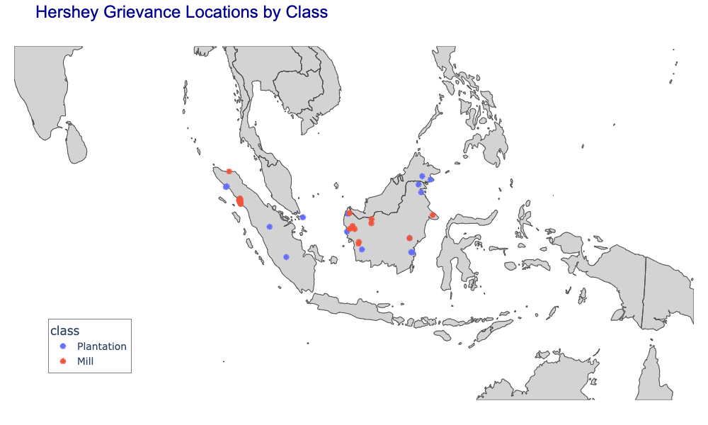
Impacted Communities (cont’d)

Slide 14
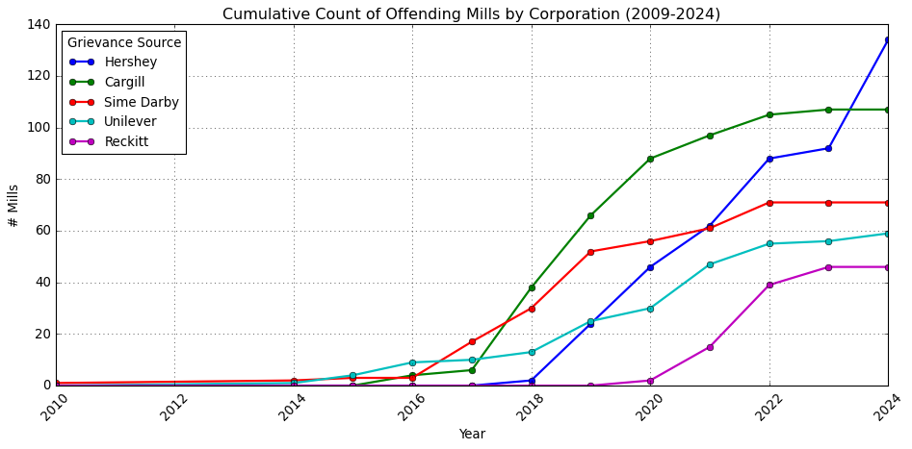
Scope of Corporate Exploitation
Notes:
Next, we analyzed the cumulative count of offending mills per corporation between 2009 and 2024.
Cargill shows a steep and consistent increase in the number of implicated mills, peaking at over 80.
Hershey follows with a delayed but still significant rise starting around 2019 that has continued through 2024.
Reckitt enters the picture more recently, around 2020, and is already approaching 40 implicated mills, and Sime Darby and Unilever are currently up to around 60 implicated mills each.
These trends suggest two possibilities: either the companies are becoming more transparent over time—or the scale of misconduct is increasing. Either way, the steepness of these curves points to systemic supply chain issues that have yet to be resolved.

Slide 15
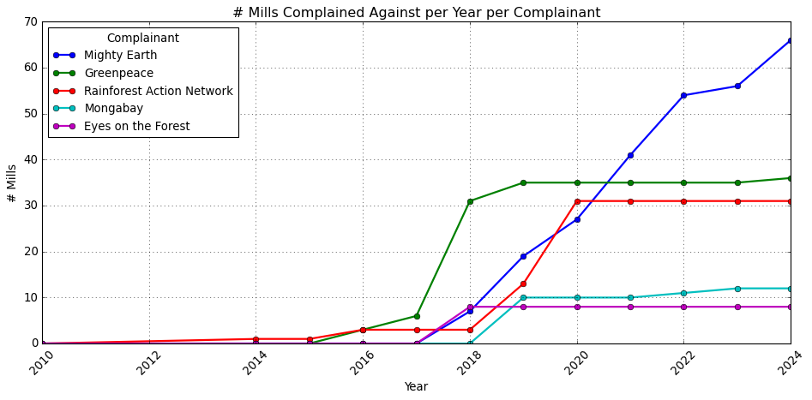
Scope of Reporting Complainants
Notes:
Finally, we flipped the lens and looked at who is reporting these grievances. The top complainants are NGOs and media watchdogs like Mighty Earth, Greenpeace, and Mongabay.
Mighty Earth has emerged as the most prolific, with its complaint count rising sharply after 2018. Greenpeace and RAN (Rainforest Action Network) also play key roles. Interestingly, some groups like Eyes on the Forest show early engagement but plateau quickly
Plateau (2020–2024) : limitations in the dataset where we only have certain complainants up until the year 2020. With a update information from the grievance sources (or perhaps better reporting practices), we would be able to run our pipeline and generate metrics like these that reflect the actual, current state of the data.
This slide highlights the imbalance: a handful of actors are doing most of the reporting. This raises questions about capacity, transparency, and who gets to hold these corporations accountable

Slide 16
Implications and Future Directions

Slide 17
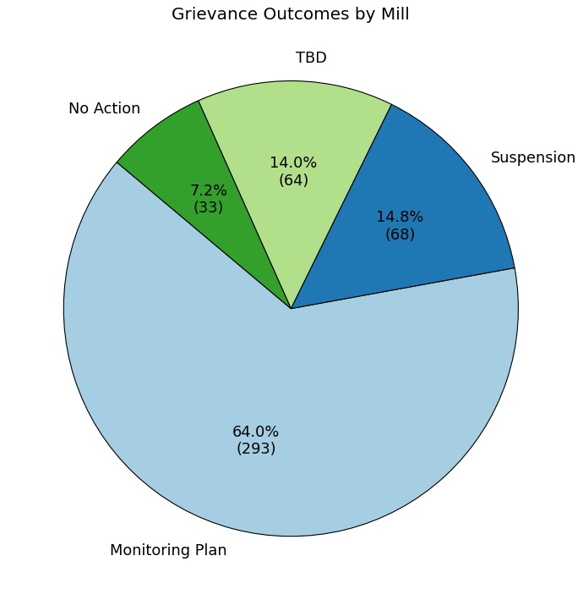
Why Does This Matter?
These five companies have suspended only 14.8% of offending mills.
458 other mills, with grievances dating back to 2009, continue to inflict unabated suffering on local communities and ecosystems.
1,302 parties - from mills to refineries to consumer suppliers - are implicated in this network.

Slide 18
Conclusion - Next Steps
Integration into PalmWatch website
Experimentation with other linkage methods
Complete tracing of supply chain relationships

